Slide 1
TENDER MANAGEMENT SYSTEM
By SUMIT RAGHAV

Slide 2
Java Backend Developer Project
Associated to: Masai School
Project developed to enable the vendors to get all the tender details online and provide facility to submit the tender.
Provides a system which will reduce the extra cost which involves for this entire process like:-
Advertising
Document processing
Getting confirmation results.
Vendors can save a lot of time. This application makes the evaluation process to complete within the assigned date.
Different vendors with provides different Bids among which some selected bids can be approved

Slide 3
Existing System:
This Tender Management System works need to be completed manually.
Contractors need to submit their documents by visiting the office or centers on time.
Contractors has to bid for particular tender on time by applying forms and needs to wait for approval reply.
The Admin Needs to post the Projects or contracts as a poster or advertisements regularly.
It takes long time to access tenders or vendors data accessing.
Not much secure.

Slide 4
Proposed System:
User Needs to Have a Network Connection.
New User needs to register as new vendor in the website.
Contractors can login and bid for some existing tenders.
They need to login using their login-id and password which they used while registration
To reduce paper work, data which are available online, using this final decision can be taken by the administration and can contact directly to such suppliers.
More data security.
Easy to access the tenders and vendors data.

Slide 5
Software Requirements:
Language : Java
Web technologies : J2EE (JDBC)
Database: MYSQL
Operating System : Windows/Linux

Slide 6
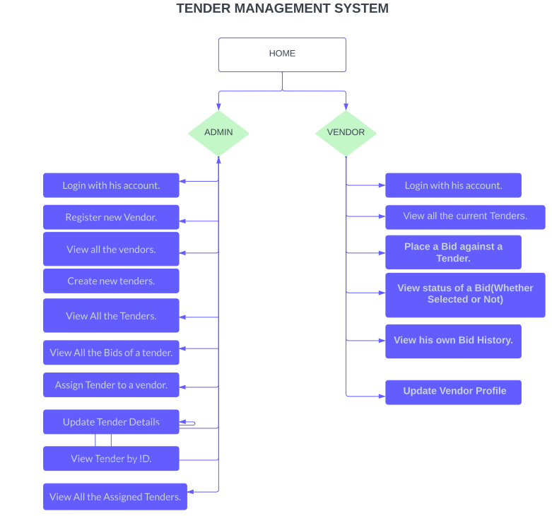
Application Workflow

Slide 7
Administrator
1. Login with his account.
2. Register new Vendor. (assign a new username and password to him)
3. View all the vendors.
4. Create new tenders.
5. View All the Tenders.
6. View All the Bids of a tender.
7. Assign Tender to a vendor.
8. Update Tender Details
9. View All the Assigned Tenders.
10. View Tender by ID.

Slide 8
The Role of a Vendor is:
1. Login with his account (username and password given by admin)
2. View all the current Tenders.
3. Place a Bid against a Tender.
4. View status of a Bid(Whether Selected or Not)
5. View his own Bid History.
6. Update Vendor Profile

Slide 9
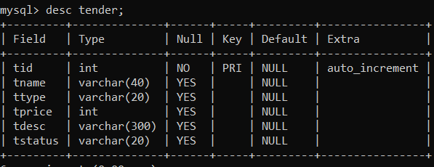
Database Description: Tender table

Slide 10
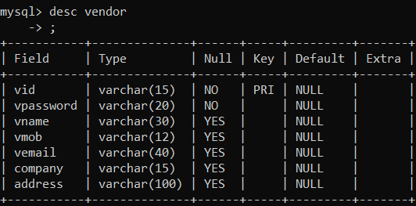
Database Description: Vendor table

Slide 11
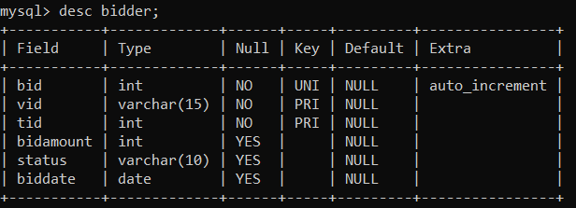
Database Description: Bidder table

Slide 12
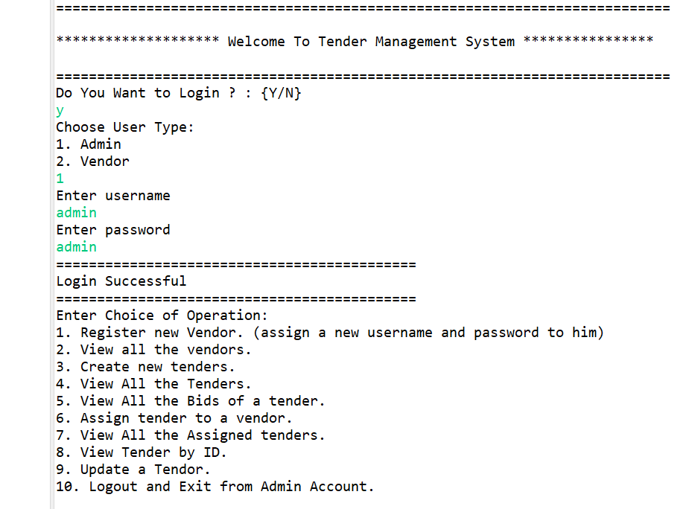
Screenshots

Slide 13
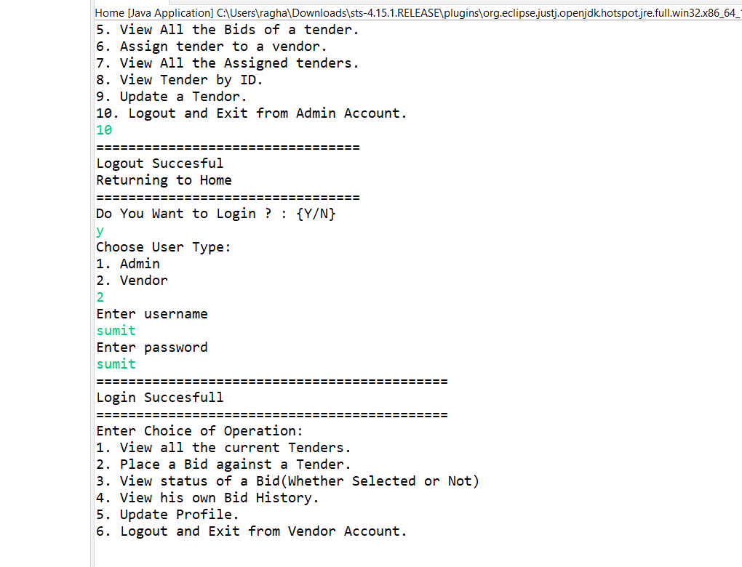
Screenshots

Slide 14
Conclusion
Our Project Tender management System Successfully Created a user friendly environment for tender management process.
This Project is flexible and changes can be incorporated easily.
Easy for further Modification
Saves a lot of time
It may leads to increase profit and improve the quality of a company.
Assigns the tenders and project in a well manner and optimal way to the contractors in less time with low cost charges.

Slide 15
THANK YOU…….

